Slide 1

E-commerce Data Warehousing and
Analytics Project

Slide 2
AGENDA
01
Data Sources
02
Data Warehouse Design
03
ETL
04
Business QA

Slide 3


Presentation
Data Warehouse Design- Ecommerce

Slide 4
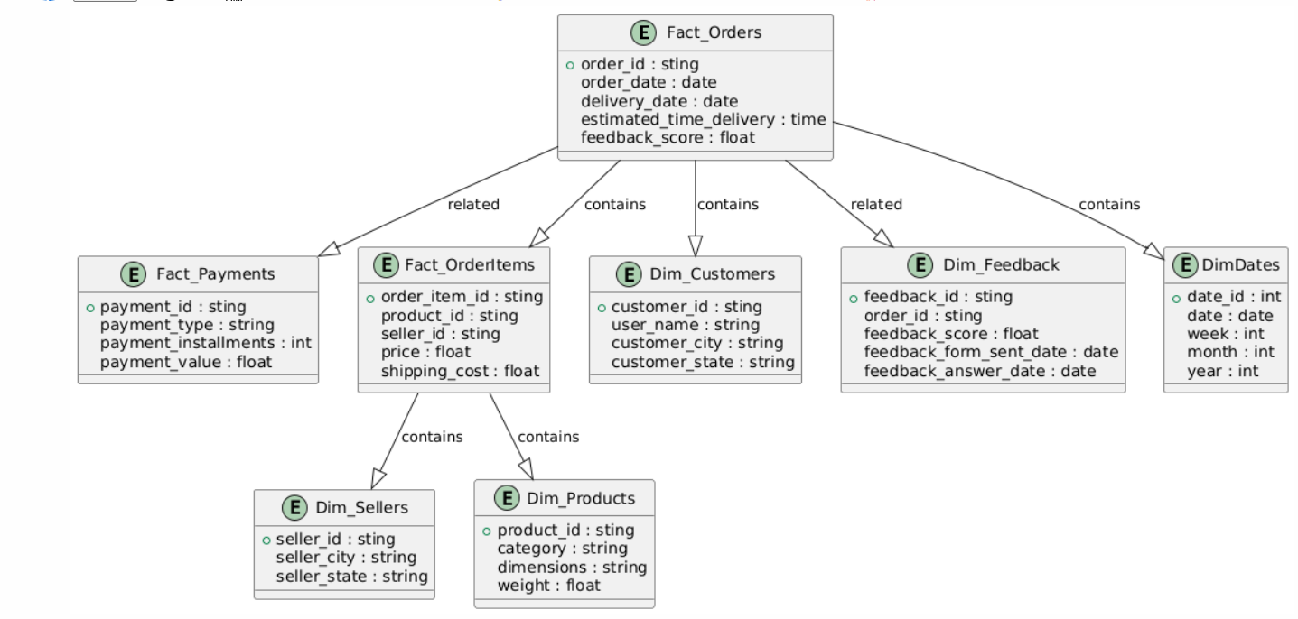
Data Warehouse Design
Star Schema
Components:
Fact Tables:
Fact Order
Fact Order Item
Fact Payment
Dimension Tables:
Dim Customer.
Dim Product.
Dim Seller.
Dim Feedback

Slide 5
ETL
Extract:
Pull data from CSV files.
Transform:
Handle Duplicates values and standardize formats and null Values.
Load:
Populate the data warehouse with transformed data.
Tools Used: SQL, Convert CSV to Insert SQL Online

Slide 6
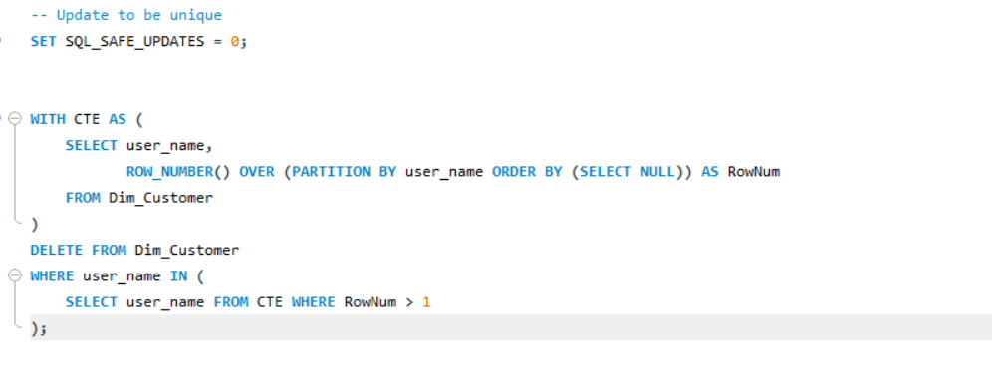
ETL Challenges
Transform:
Dim Customer:
Check duplicate
Remove duplicate user name

Slide 7
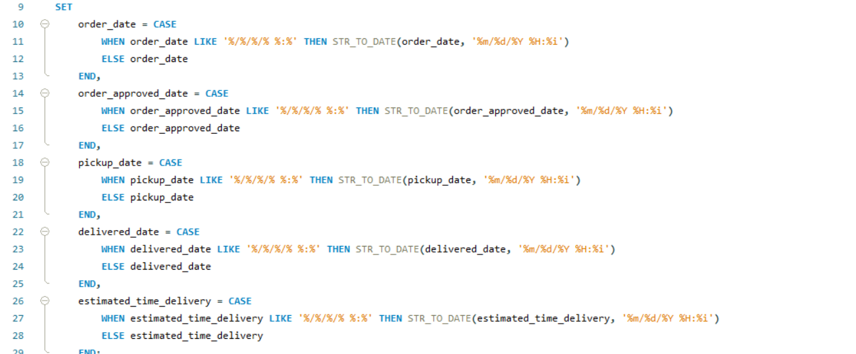
ETL Challenges
Transform:
Fact order:
Formats Transactional times

Slide 8
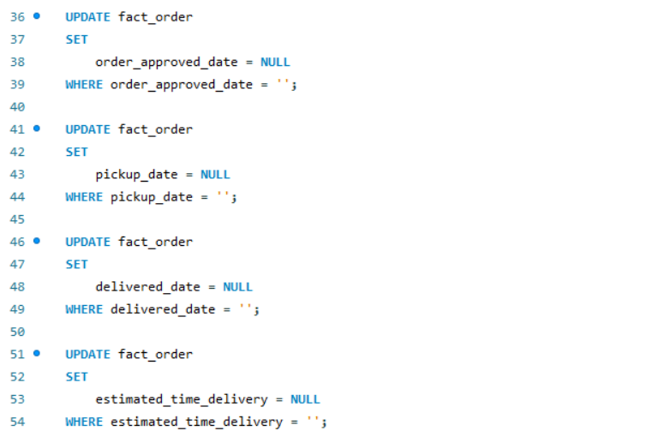
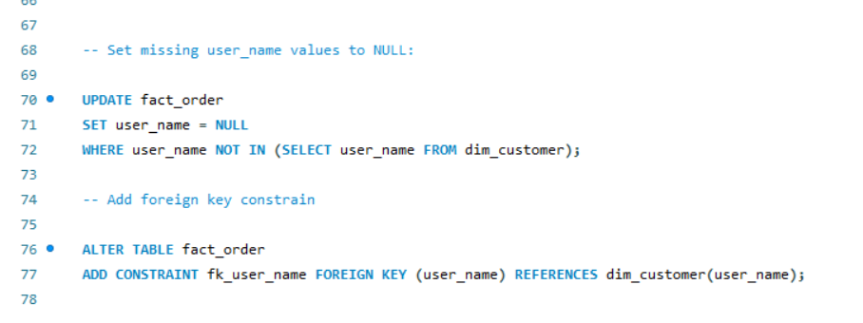
ETL Challenges
Transform:
Fact order:
Handle nulls in Transactional Times
Transform:
Fact order:
Missing Foreign Key

Slide 9
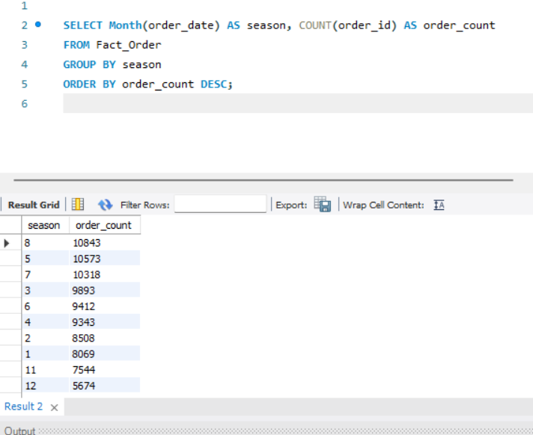
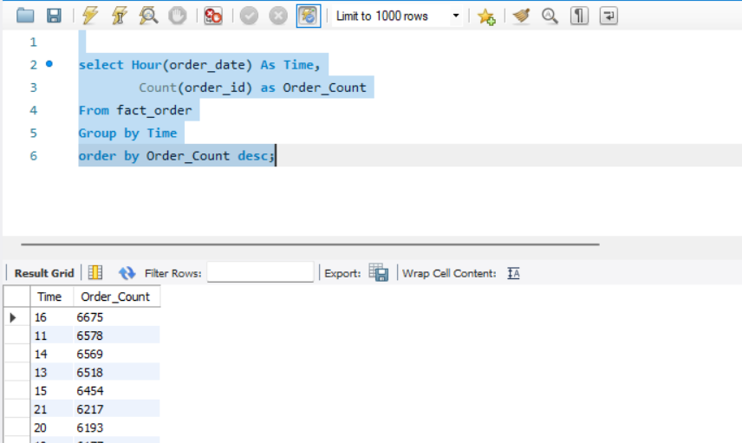
Business Review
When is the peak season of our e-commerce?
2.What time users are most likely make an order or using the ecommerce app?

Slide 10
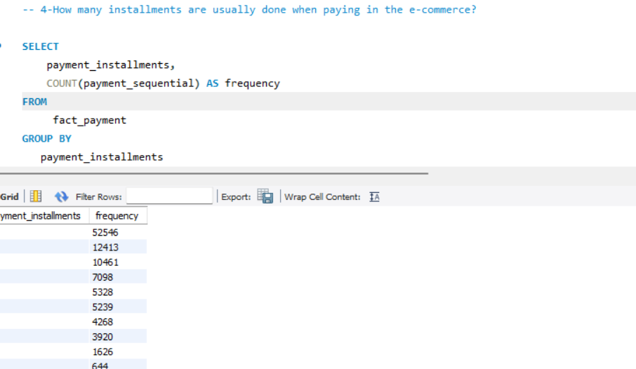
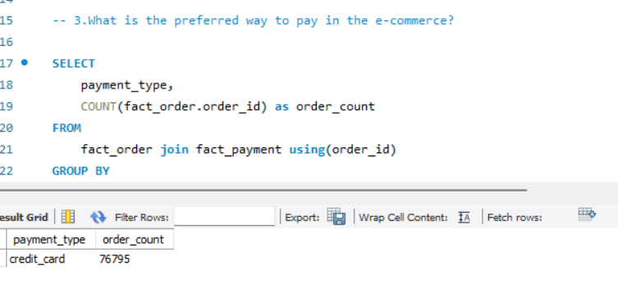
Business Review
3. What is the preferred way to pay in the ecommerce?
4. how many installment is usually done when paying in the ecommerce?

Slide 11
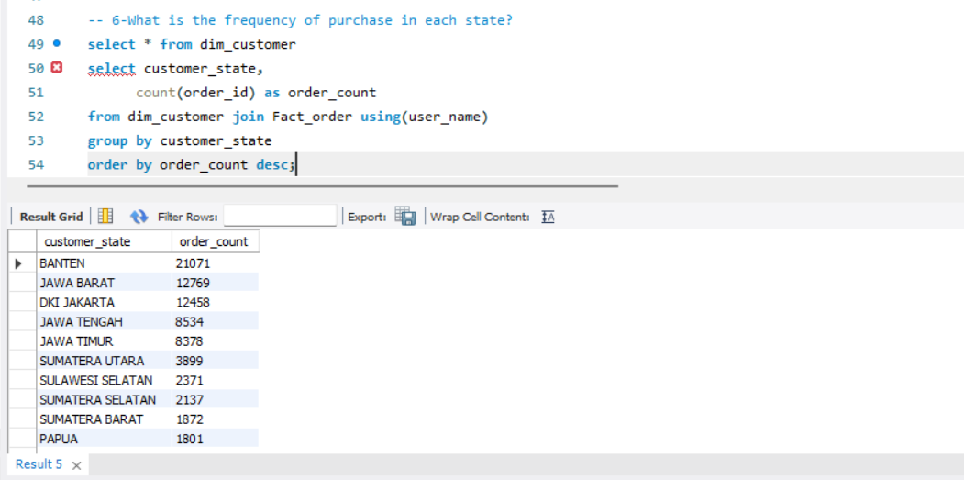
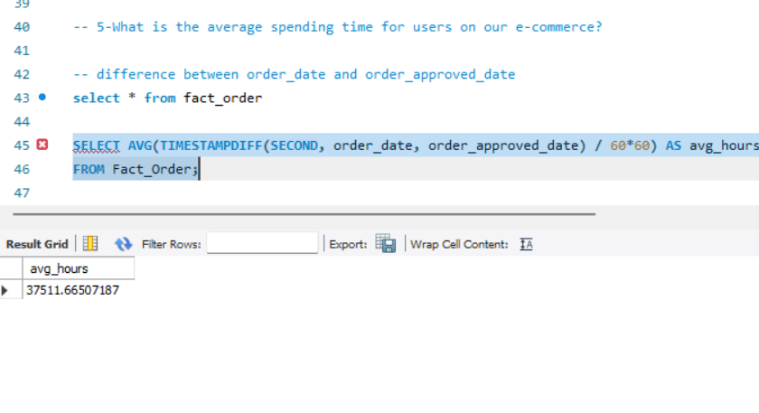
Business Review
5. What is the average spending time for user for our ecommerce?
6. What is the frequency of purchase on each state?

Slide 12
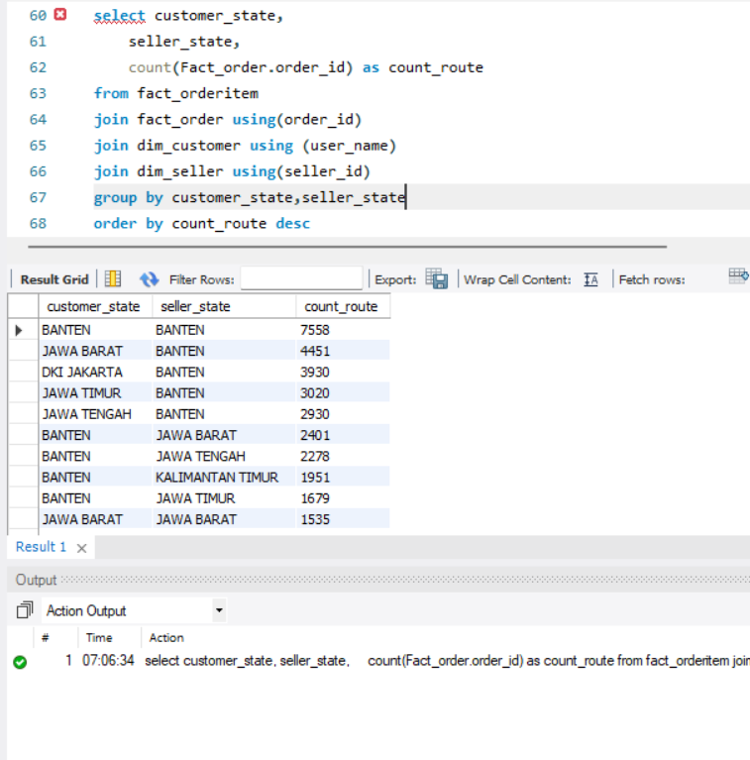
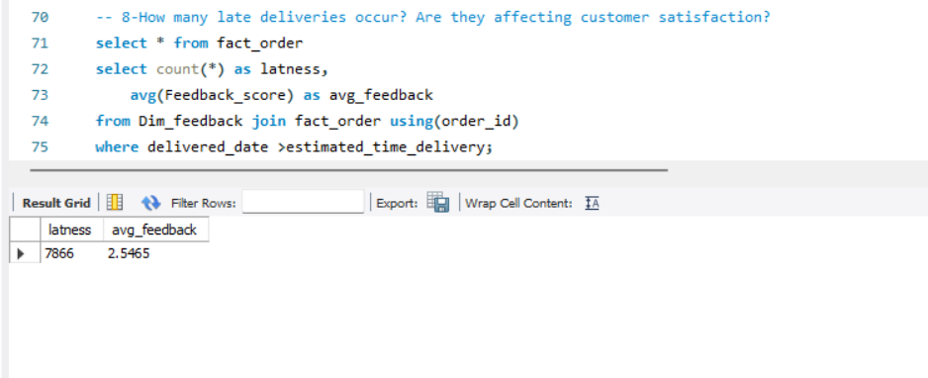
Business Review
7. Which logistic route that have heavy traffic in our ecommerce?
8. How many late delivered order in our ecommerce? Are late order affecting the customer satisfaction?

Slide 13
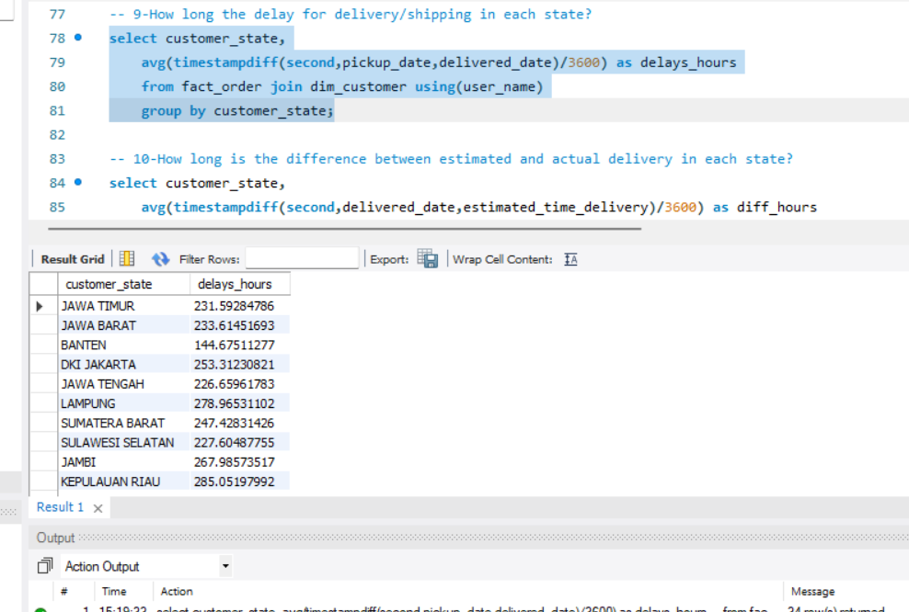
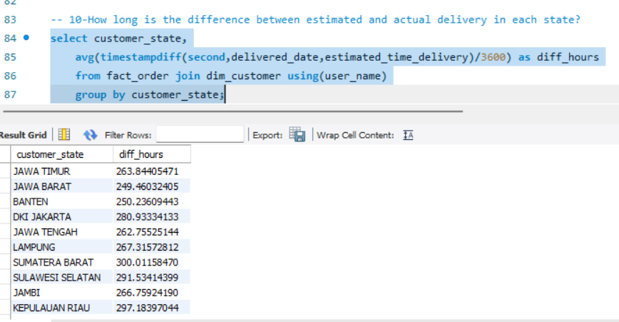
Business Review
9.How long is the difference between estimated delivery time and actual delivery time in each state.
10. How long are the delay for delivery / shipping process in each state?

Slide 14
Presentation
THANK YOU
END.

